Slide 1

WELCOME

Slide 2

CYBER SECURITY

Slide 3
INTRODUCTION
The term cyber security is used to refer to the security offered
Through on-line services to protect your online information.
With an increasing amount of people getting connected to
Internet, the security threats that cause massive harm are
Increasing also.
c

Slide 4
To Understand
what is the
Meaning of
the word
CYBER
What is the need
of Cyber security
How to
Implement and
maintain
security of a
Cyber field
around us.
what are the
security
Problems in
Cyber field

Slide 5

Meaning of the Word
It is a combining from relating to information
technology, the internet, and virtual reality.

Slide 6

Need of cyber security
cyber security in necessary sicne it help in
Securing data from threats such as data theft or
Misuse, also safeguards your system from viruses.

Slide 7

Major security problems
Virus
Hacker
Malware
Trojan horses
Password cracking

Slide 8
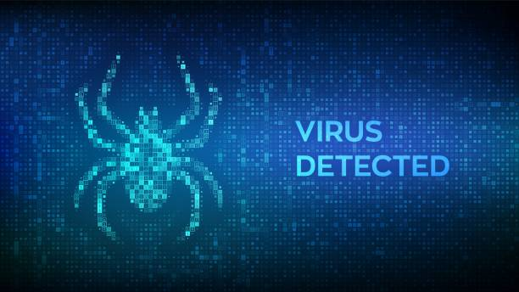
Virus and Worms
A virus is a “program that is loaded onto your computer without your knowledge and runs against your wishes

Slide 9
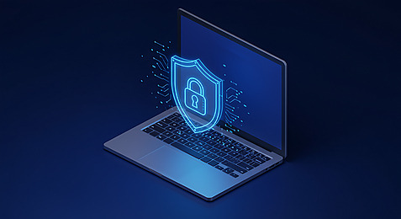
Solution
Install a security suite that protects the computer
Against threats such as viruses and worms.

Slide 10
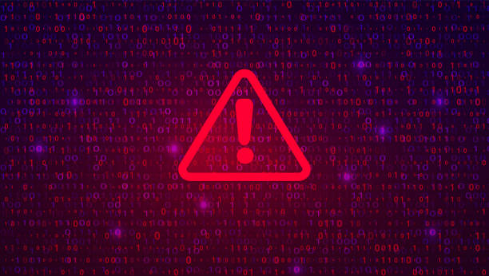
Hackers
In common a Hacker is a person who breaks into computers, usually by gaining access to administrative controls.

Slide 11

How to prevent hacking
It may be impossible to prevent computer hacking, however effective security controls including strong passwords, and the use of firewalls can helps.

Slide 12
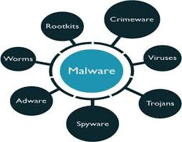
Malware
The word “malware” comes from term
“MALicious software.”
Malware is any software that infects and damages a computer system without the owner’s knowledge or permission.

Slide 13

To Stop Malware
Download an anti-malware program
that also help prevent infection.
Activate network threat
protection, firewall, antivirus.

Slide 14
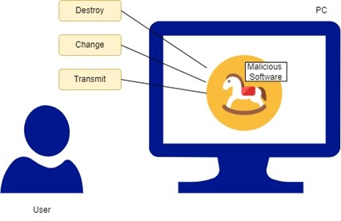
Trojan Horses
Trojan horses are email viruses that can
duplicate themselves, steal information,
or harm the computer system.
These viruses are the most serious
threats to computers.

Slide 15
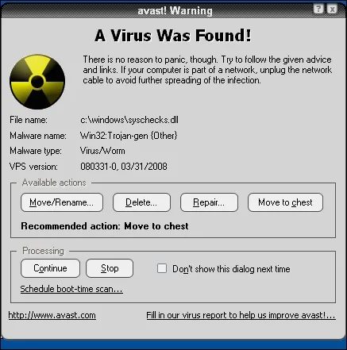
How to avoid trojans
Security suites, such as Avast internet security, will prevent you from downloading
trojan horses.

Slide 16
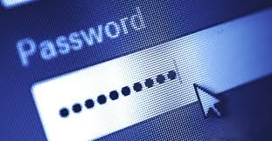
Password cracking
Password attacks are attacks by hackers that are able to determine passwords or find password to different protected electronic areas and social network sites.

Slide 17
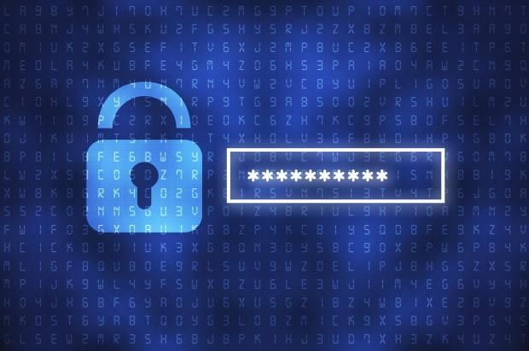
Securing password
Use always strong password.
Never use same password for tow different sites.

Slide 18

CYBER SECURITY IS EVERYONE’S RESPONSIBILITY

Slide 19
Conclusion
I hope my presentation will be helpful for my audience to improve their knowledge about cyber security. Also it helps to spread awareness among normal people about emerging security threats.

Slide 20


